Slide 1








DIGITAL. INNOVATION. SCALE

Slide 2

Agenda
Flyweight design patterns
What is Flyweight Design Pattern
When to use
Examples
Pros and Cons
What we need
Questions and answers

Slide 3
What is Flyweight Design Pattern
Structural Design Pattern
Use sharing to support large numbers of fine-grained objects efficiently.
For example, to represent a text document at the finest levels, an object is needed for every character in the document, which may result in a huge amount of objects.

Slide 4
What is Composite Design Pattern
The Flyweight pattern describes how to solve such problems:
Use sharing to support large numbers of fine-grained objects efficiently.
Define Flyweight objects that store intrinsic (invariant) state.
Clients share Flyweight objects and pass in extrinsic (variant) state dynamically at run-time when they invoke a flyweight operation (flyweight.operation(extrinsicState)).
Intrinsic state is invariant (context independent) and therefore can be shared.
Extrinsic state is variant (context dependent) and therefore can not be shared and must be passed in.

Slide 5
What is Composite Design Pattern
The Flyweight pattern describes how to solve such problems:
Define separate Flyweight objects that store intrinsic (invariant) state.
Clients share Flyweight objects and pass in extrinsic (variant) state instead of creating an object each time it is needed.
Intrinsic state is invariant (context independent) and therefore can be shared. For example, the code of a character in the used character set.
Extrinsic state is variant (context dependent) and therefore can not be shared. For example, the position of a character in the document.

Slide 6
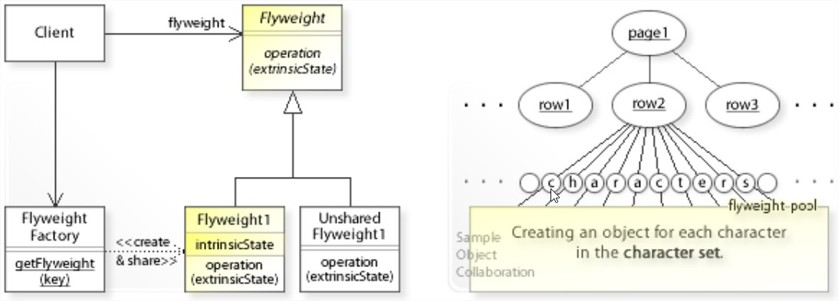
Example

Slide 7
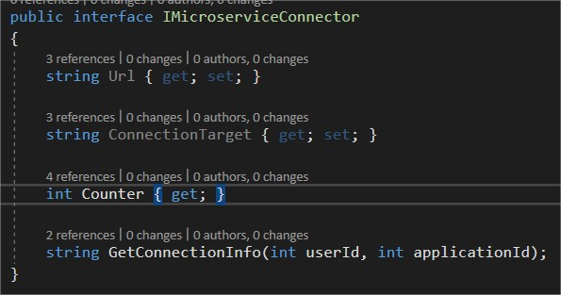
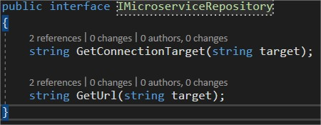
Example

Slide 8
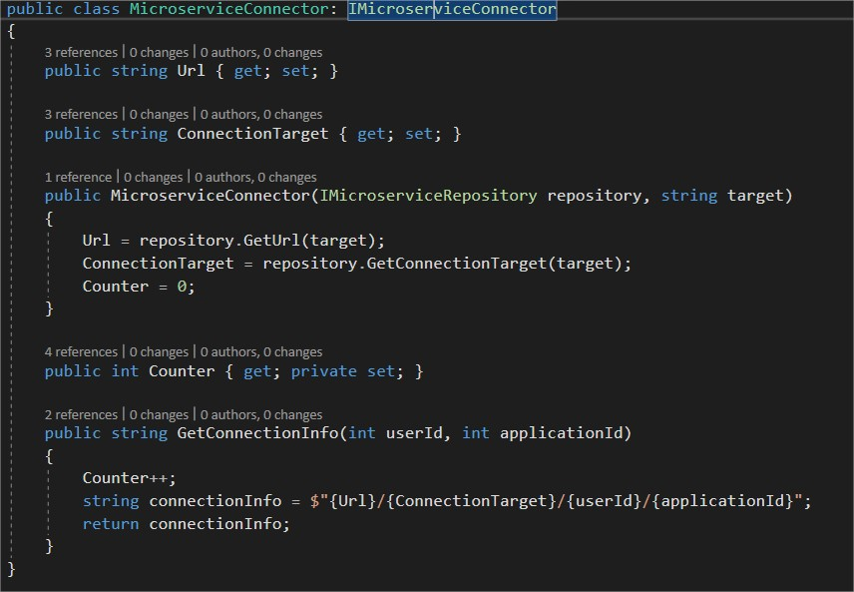
Example

Slide 9
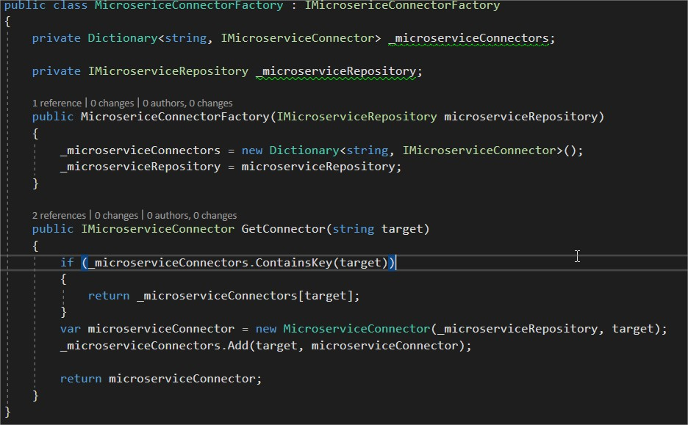
Example

Slide 10
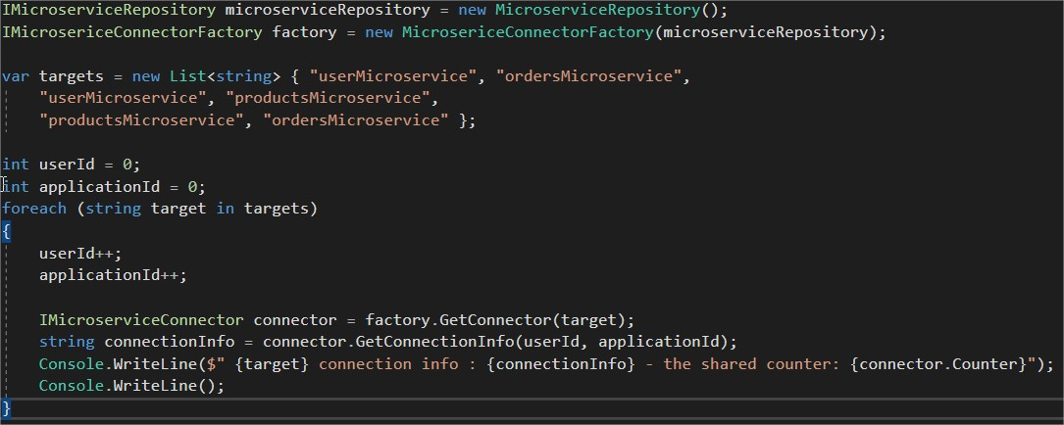
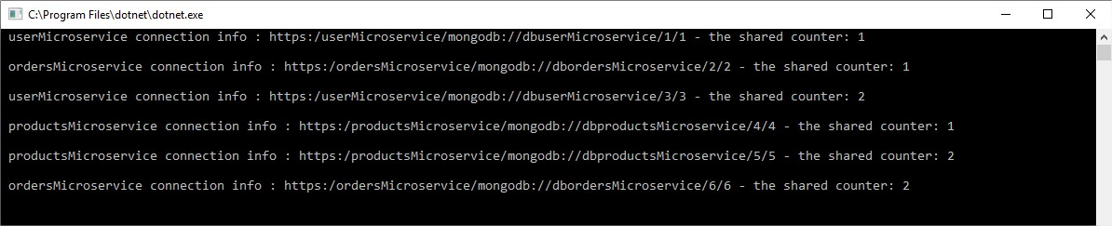
Example

Slide 11
What we need
Large number of objects / “heavy objects”
A object that has states that can be shared (Intrinsic state) and states that cannot be shared (Extrinsic state)
Factory/Provider
Client

Slide 12
Questions

Slide 13
References
GOF – Design Patterns - http://www.w3sdesign.com/GoF_Design_Patterns_Reference0100.pdf
Dotfactory - https://www.dofactory.com/net/design-patterns
Code example - https://gitlab.softvision.ro/enterprise.net/design-patterns/flyweight
Git hub: https://github.com/svdcretu/designPatterns/tree/master/Structural/ Flyweight

